Slide 1
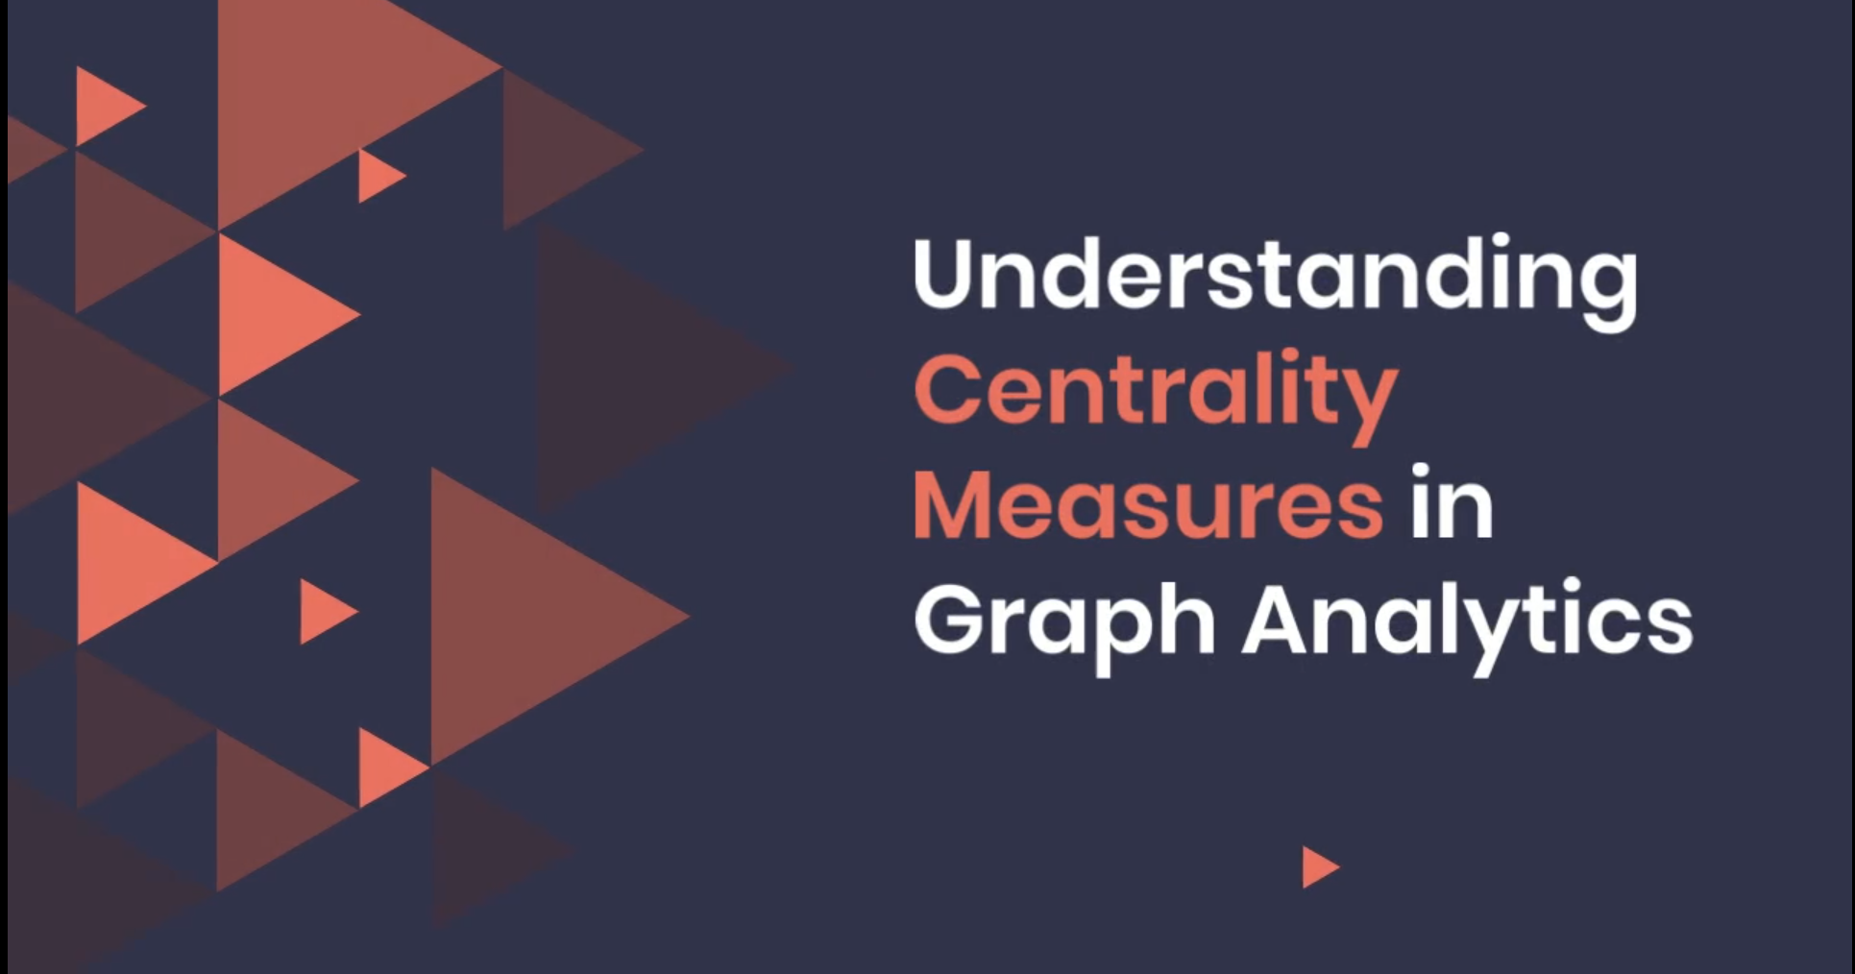

Slide 2
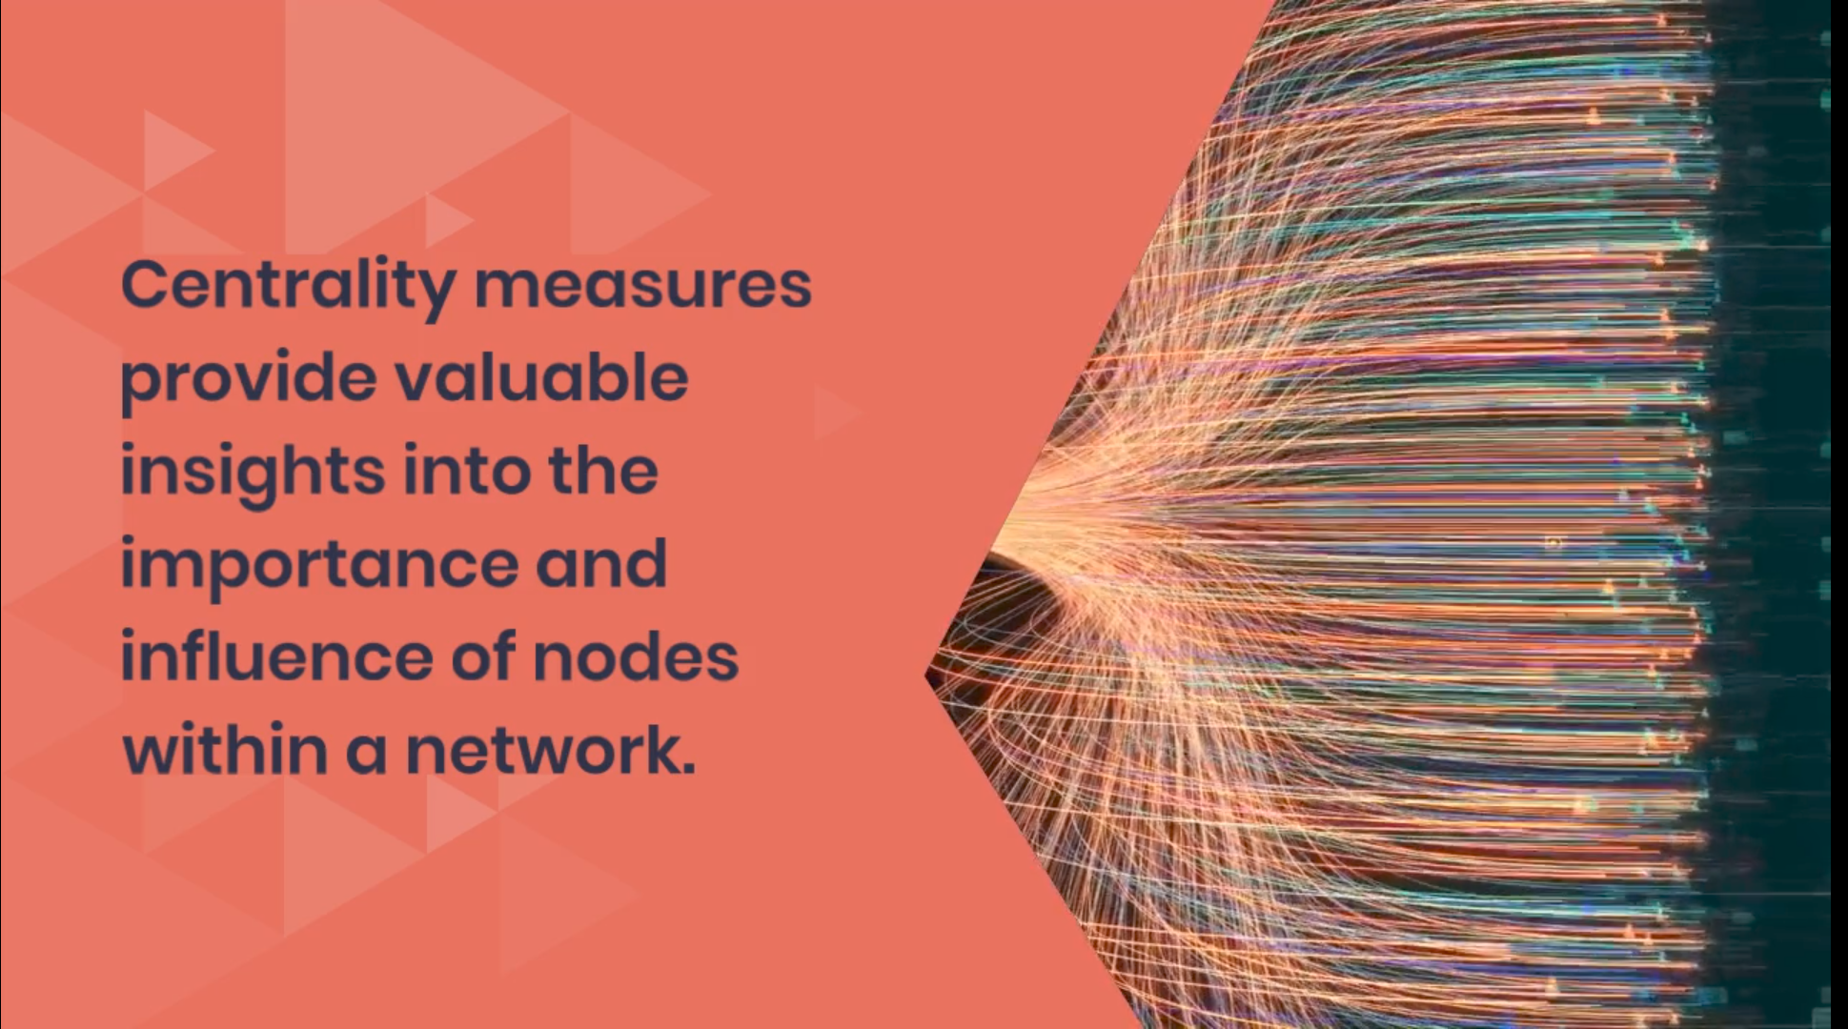

Slide 3


Slide 4


Slide 5
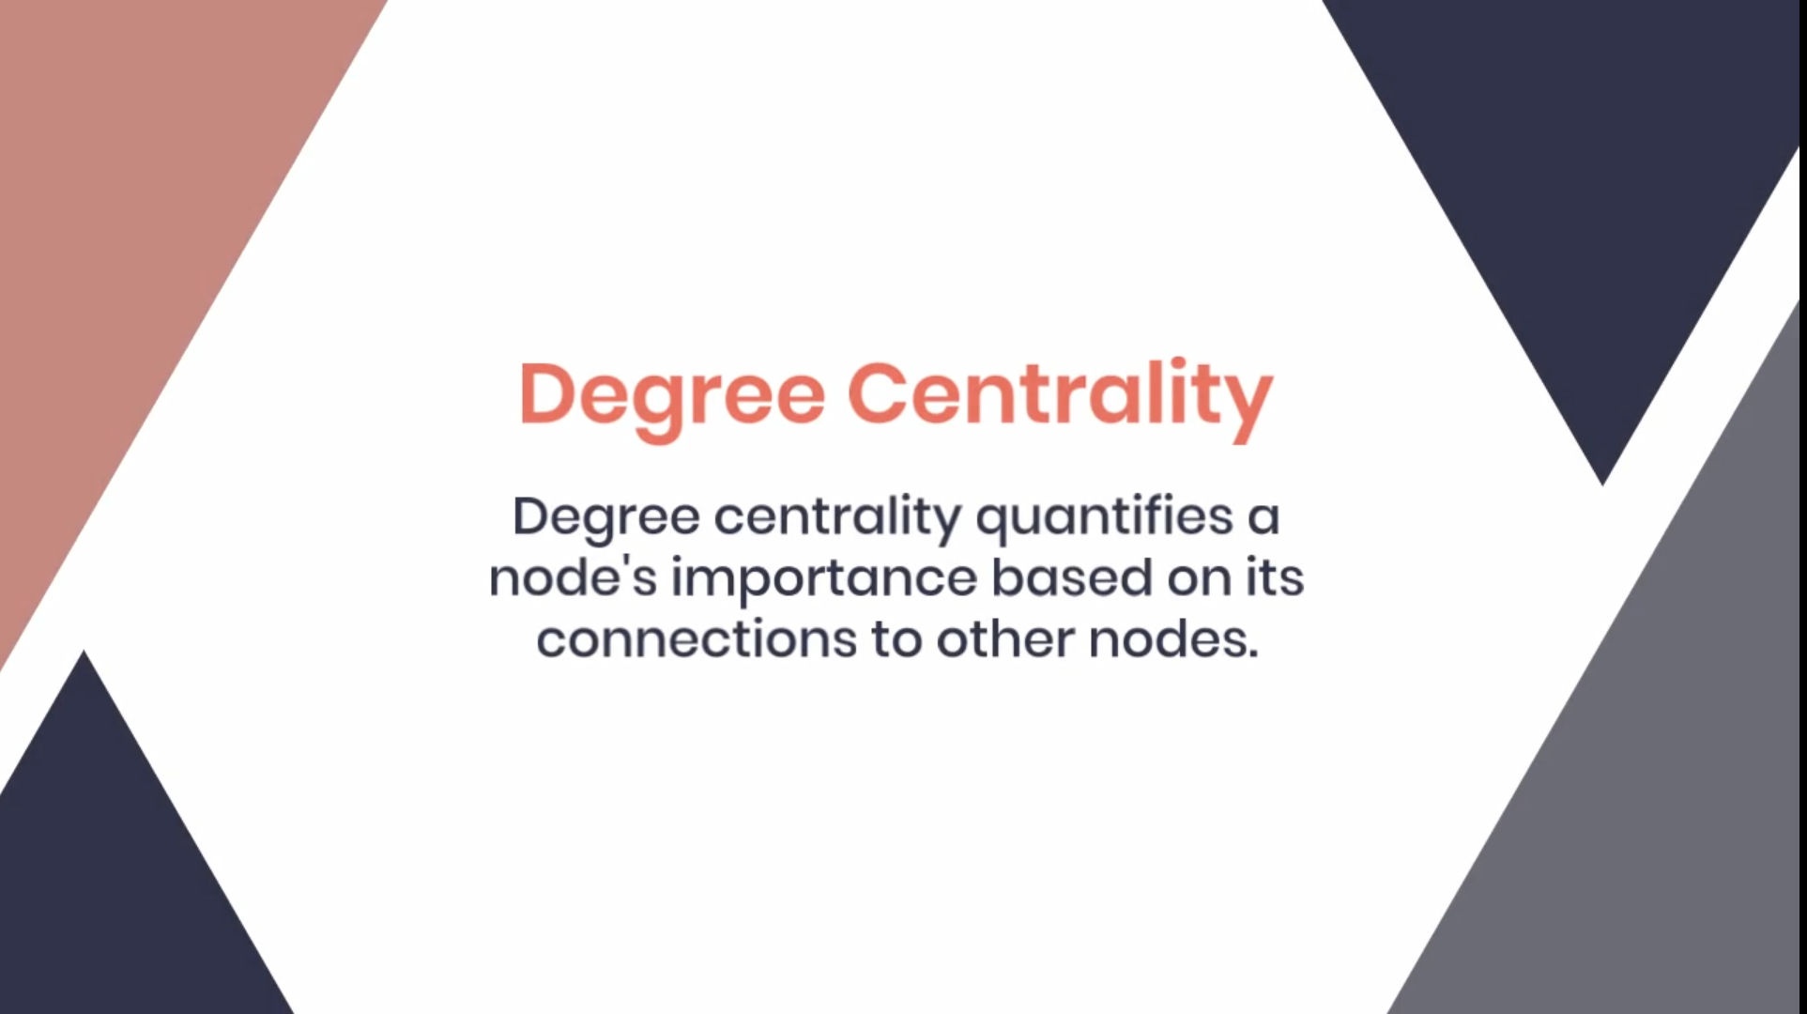

Slide 6


Slide 7
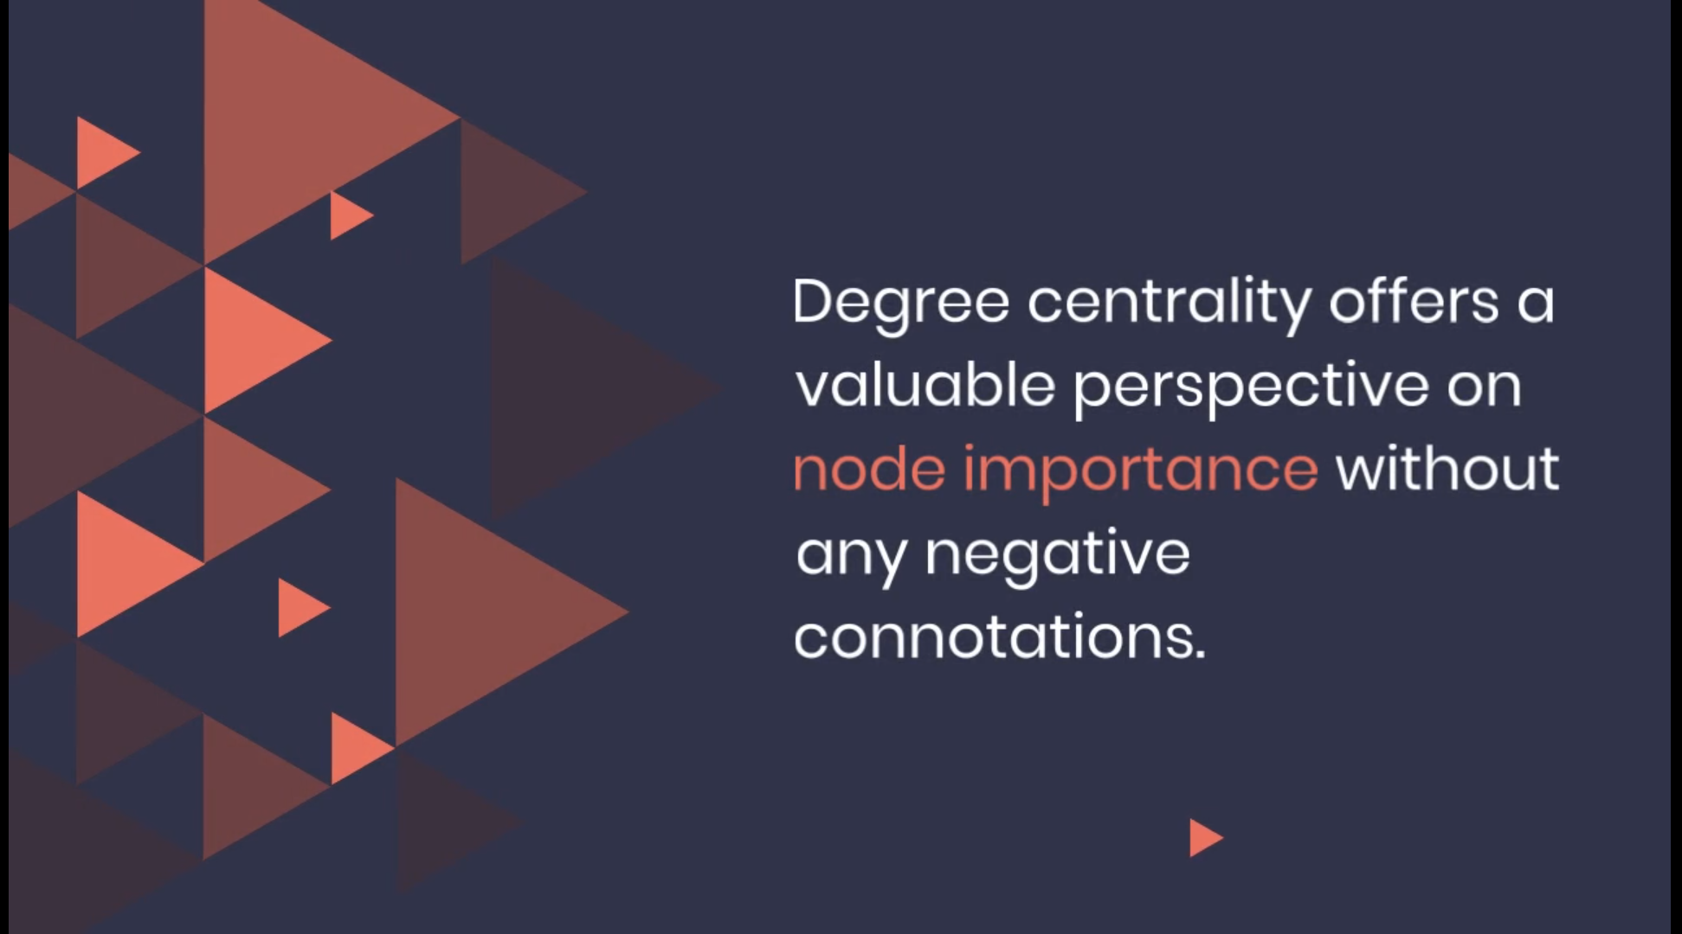

Slide 8
Definition of degree centrality
Degree centrality is a fundamental measure in network analysis that quantifies the importance of a node within a graph based on its degree, which represents the number of connections it has to other nodes. It serves as a simple and intuitive indicator of node prominence, with nodes having a higher degree of centrality considered more central or influential in the network.

Slide 9
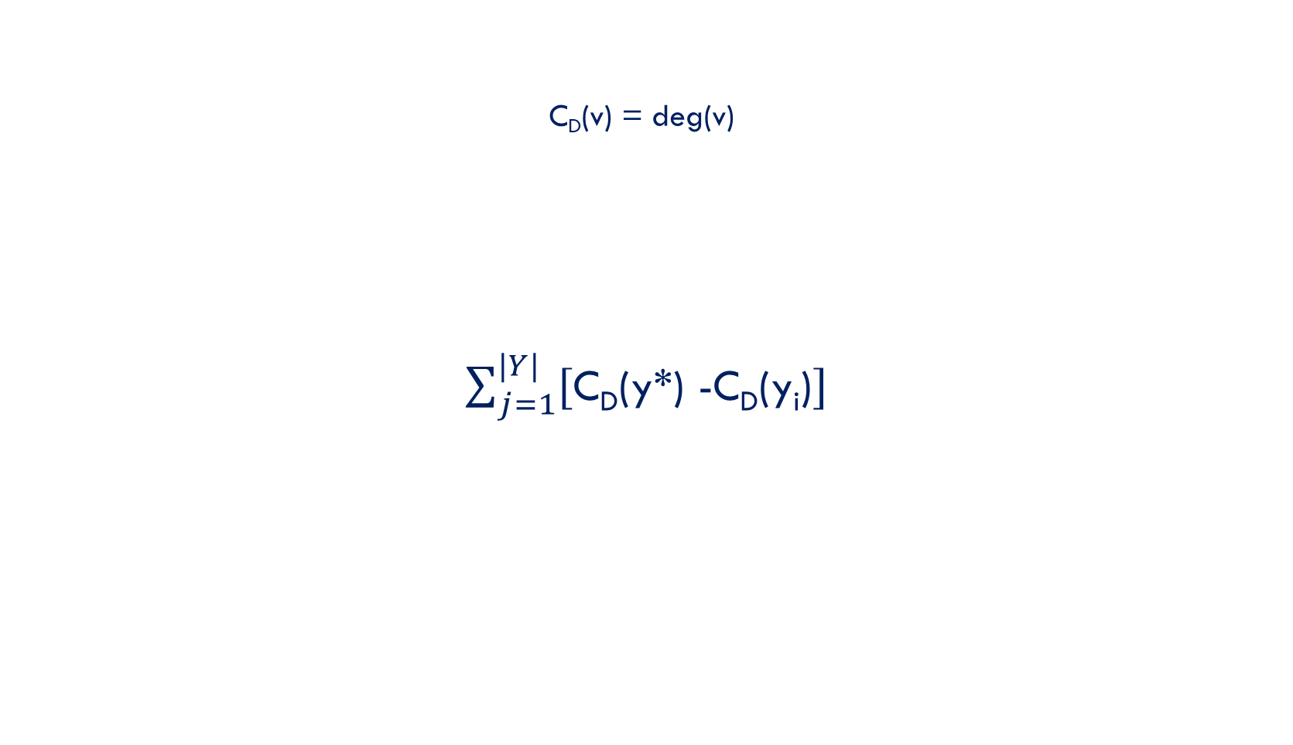
Calculating Degree Centrality
In a given graph G(V, E), for a given vertex v, the degree centrality is defined as the following – C_{d}(v) = deg(v)
Let X(Y, Z) be the |Y| node connected graph, with |Y| vertices and |Z| edges, that maximizes the following quantity (where y∗ is node with highest degree centrality in |X|): $\sum_{j=1}^{|Y|}{[\text{C}\text{d}\text{(}\text{y}\text{*}\text{)}\text{ -}\text{C}\text{d}\text{(}\text{y}\text{i}\text{)}]}$ The value of H is maximized when graph X contains one central node to which all other nodes are connected (star topology). In that case, H = (n − 1) × ((n −1)−1) = N² – 3N +2

Slide 10
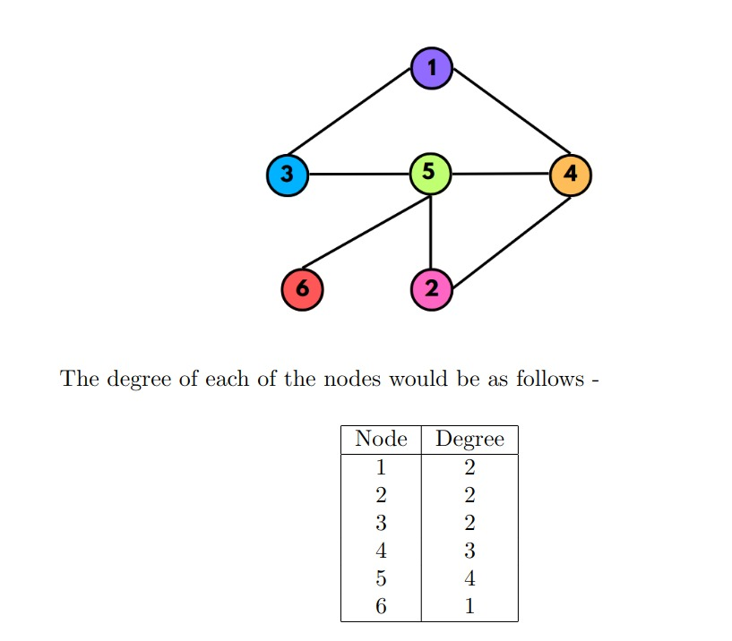
Example for degree centrality

Slide 11
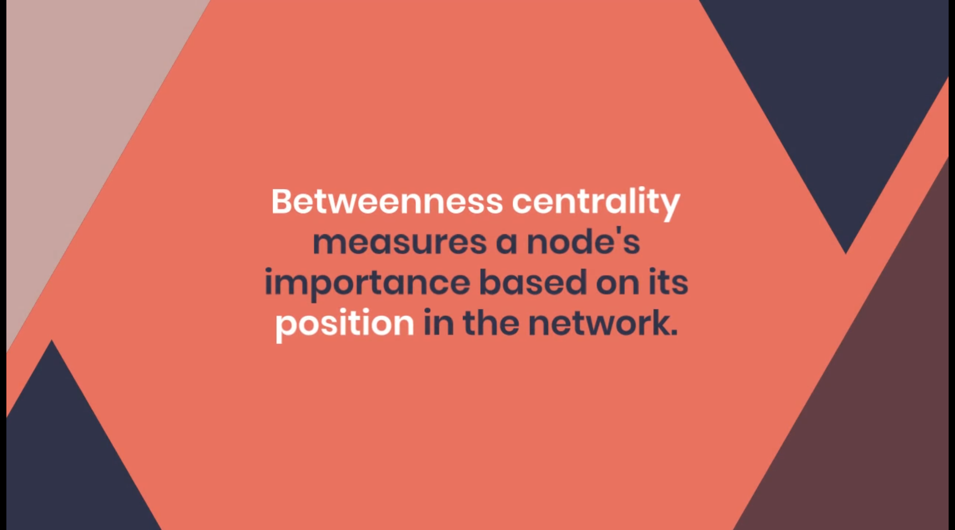

Slide 12
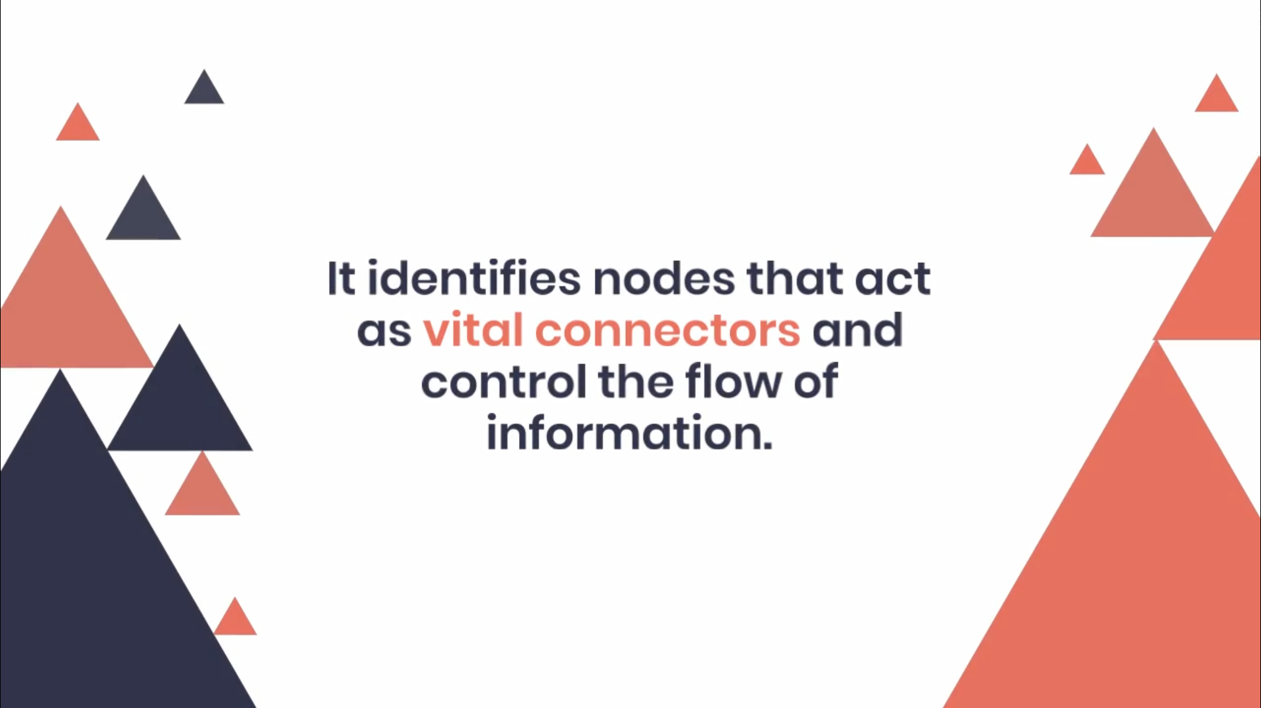

Slide 13
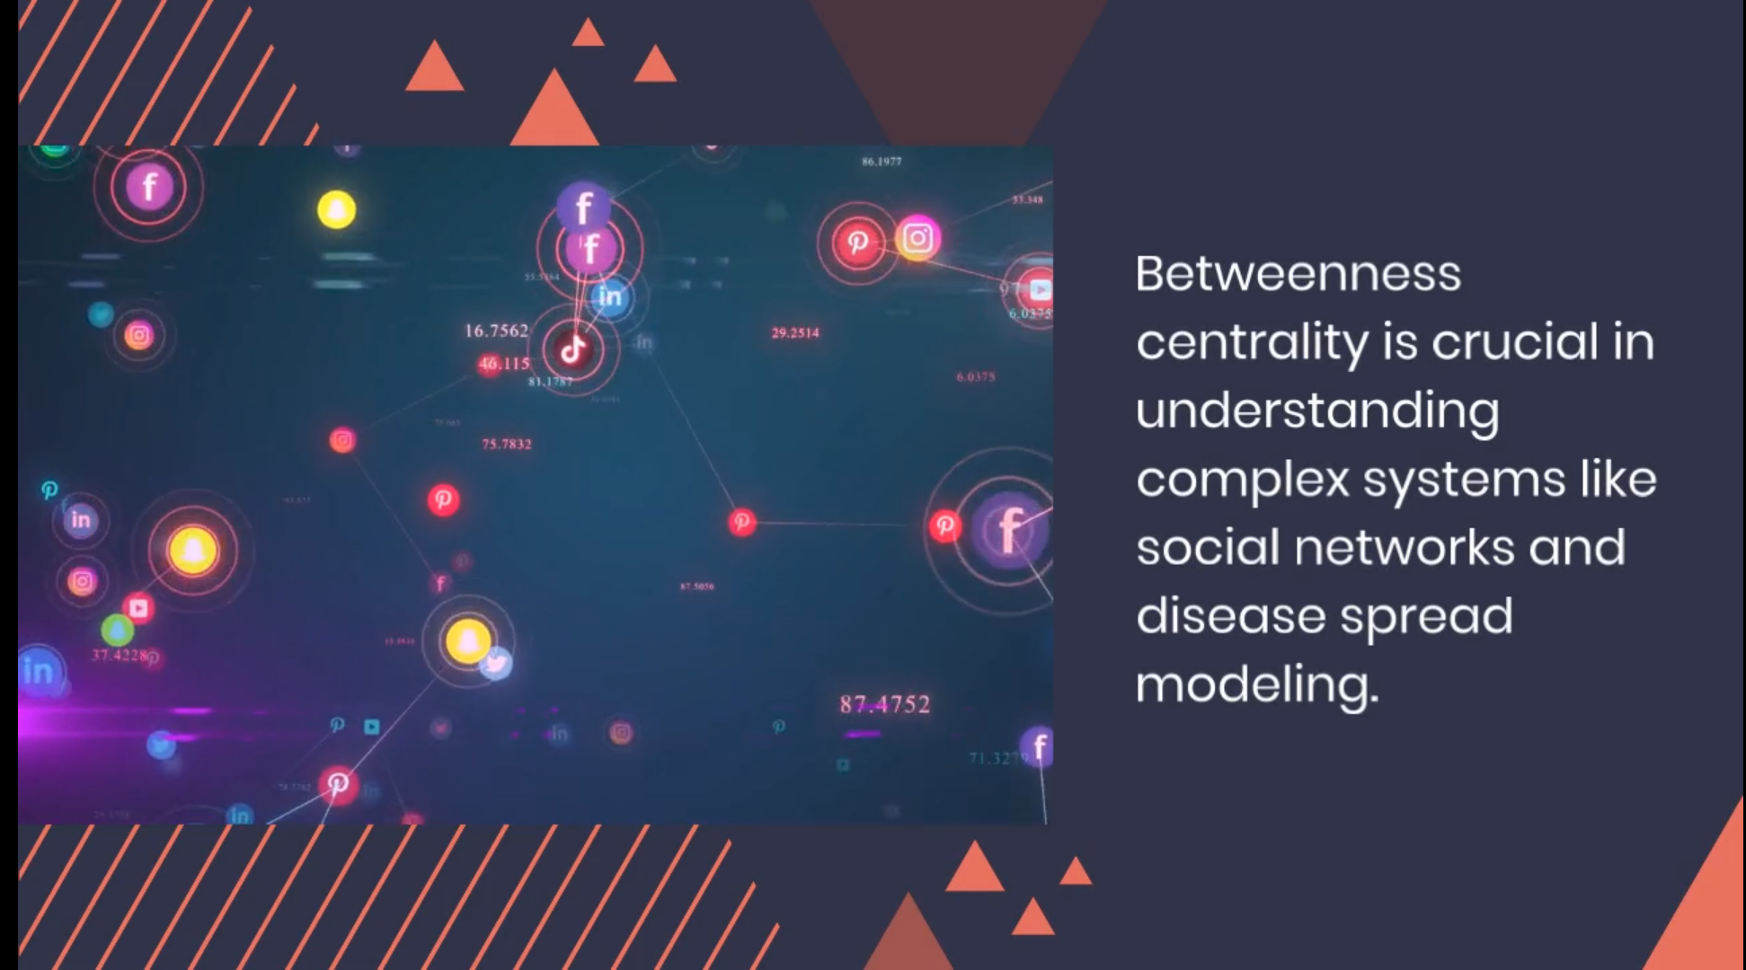

Slide 14
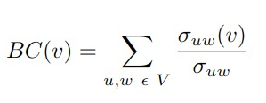
Definition of betweenness centrality
Betweenness centrality is a metric that assesses the significance of a node in a network based on its frequency in the geodesic distance or shortest path between all pairs of nodes. The betweenness centrality of a vertex v in a graph can be calculated using the following formula:
Where V represents the set of all nodes in the graph, σuw denotes the total number of shortest paths between node u and w (u, w are distinct), and σuw (v) is the total number of shortest paths between nodes u and w that pass through vertex v.

Slide 15
Calculating Betweenness centrality
1. Calculate unique pairs of nodes (unique edges):
Start by considering all possible pairs of nodes in the graph. These pairs represent the edges or connections between nodes.
2. Determine the shortest paths:
Find the shortest paths between all pairs of nodes in the graph. This can be done using algorithms such as Dijkstra’s algorithm or Floyd-Warshall algorithm. In case of a weighted graph, the paths should be minimal weighted paths.

Slide 16
Calculating Betweenness centrality
3. Calculate the sum of all fractions of shortest paths through vertex v:
For each pair of nodes (u, w) calculate the number of shortest paths between them (σuw) and the number of paths that pass through the vertex v (σuw(v)). Then, sum up the fractions σuw/σuw(v) for all pairs of nodes in which vertex v lies on the shortest path.
4. Normalize the betweenness centrality (BC):
If you are comparing networks of different sizes, it is common practice to normalize the betweenness centrality scores. This normalization takes into account the fact that larger networks tend to have higher centrality scores. There are various normalization techniques, such as dividing each node’s betweenness centrality by the maximum possible betweenness centrality value.

Slide 17
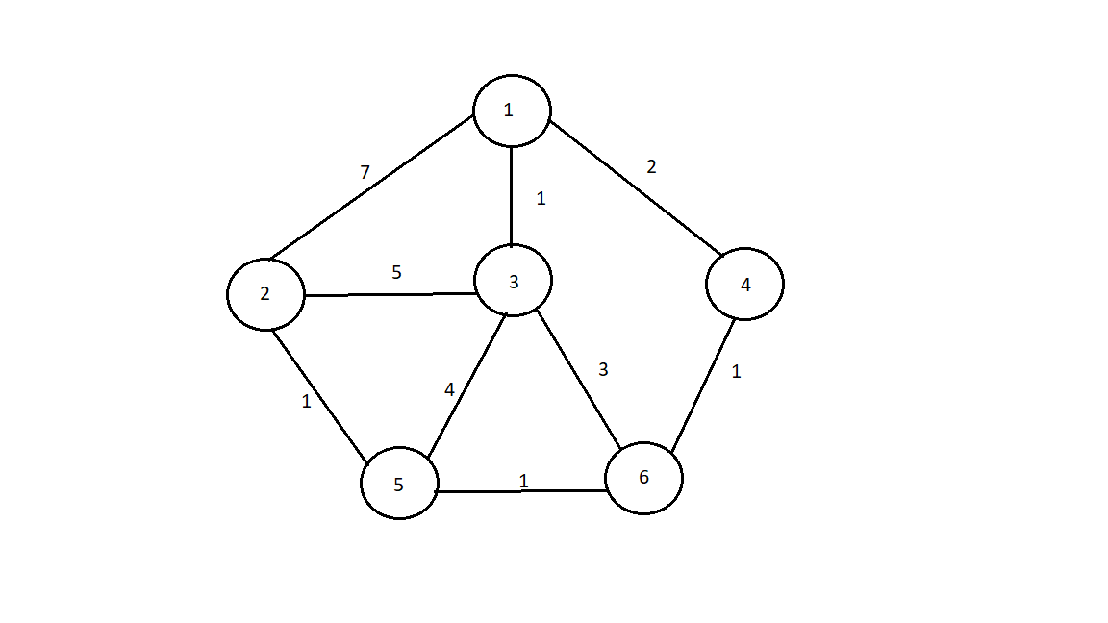
Example for Betweenness Centrality

Slide 18
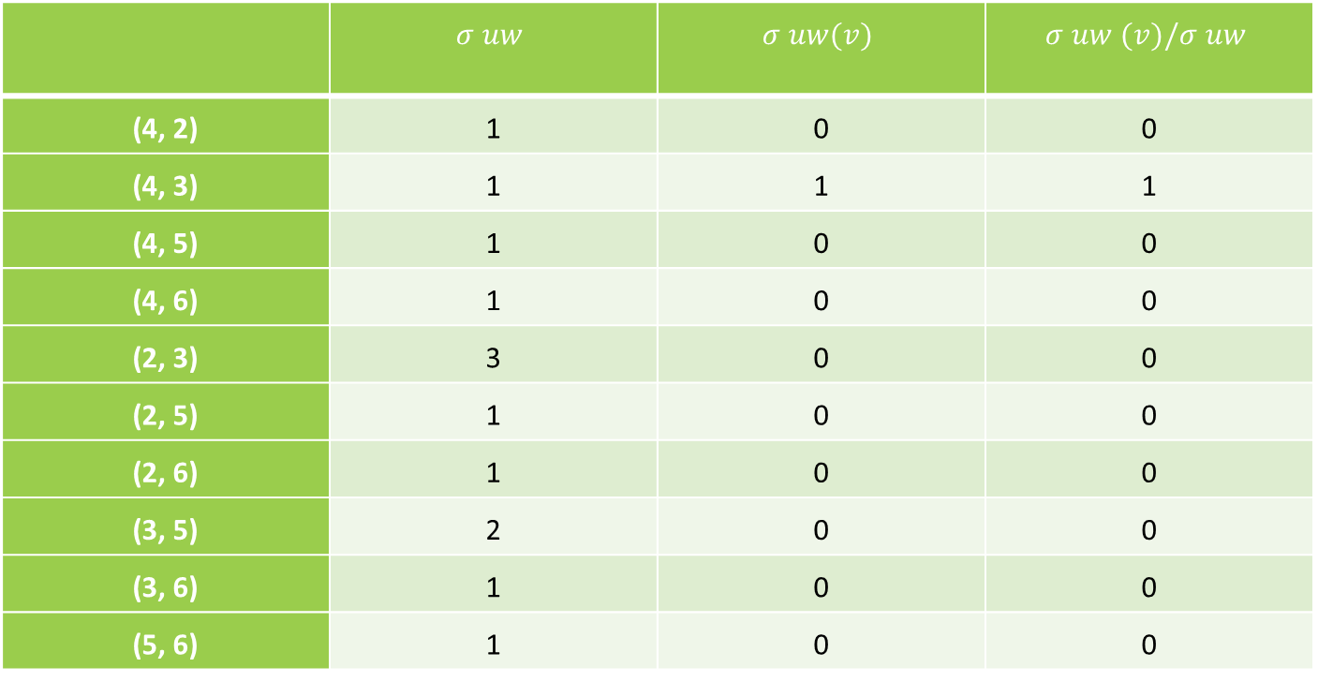
For node 1:
 | $$σ uw$$ | $$σ uw(v)$$ | $$σ uw (v)/σ uw$$
(4, 2) | 1 | 0 | 0
(4, 3) | 1 | 1 | 1
(4, 5) | 1 | 0 | 0
(4, 6) | 1 | 0 | 0
(2, 3) | 3 | 0 | 0
(2, 5) | 1 | 0 | 0
(2, 6) | 1 | 0 | 0
(3, 5) | 2 | 0 | 0
(3, 6) | 1 | 0 | 0
(5, 6) | 1 | 0 | 0
Hence, betweenness centrality of 1 is: 1

Slide 19

For node 2:
 | $$σ uw$$ | $$σ uw(v)$$ | $$σ uw (v)/σ uw$$
(1, 4) | 1 | 0 | 0
(1, 3) | 1 | 0 | 0
(1, 5) | 1 | 0 | 0
(1, 6) | 1 | 0 | 0
(4, 3) | 3 | 0 | 0
(4, 5) | 1 | 0 | 0
(4, 6) | 1 | 0 | 0
(3, 5) | 2 | 0 | 0
(3, 6) | 1 | 0 | 0
(5, 6) | 1 | 0 | 0
Hence, betweenness centrality of 2 is: 0

Slide 20

For node 3:
 | $$σ uw$$ | $$σ uw(v)$$ | $$σ uw (v)/σ uw$$
(1, 2) | 1 | 0 | 0
(1, 4) | 1 | 0 | 0
(1, 5) | 1 | 0 | 0
(1, 6) | 1 | 0 | 0
(2, 4) | 1 | 0 | 0
(2, 5) | 1 | 0 | 0
(2, 6) | 1 | 0 | 0
(4, 5) | 2 | 0 | 0
(4, 6) | 1 | 0 | 0
(5, 6) | 1 | 0 | 0
Hence, betweenness centrality of 3 is: 0

Slide 21

For node 4:
 | $$σ uw$$ | $$σ uw(v)$$ | $$σ uw (v)/σ uw$$
(1, 2) | 1 | 1 | 1
(1, 3) | 1 | 0 | 0
(1, 5) | 1 | 1 | 1
(1, 6) | 1 | 1 | 1
(2, 3) | 3 | 0 | 0
(2, 5) | 1 | 0 | 0
(2, 6) | 1 | 0 | 0
(3, 5) | 2 | 0 | 0
(3, 6) | 1 | 0 | 0
(5, 6) | 1 | 0 | 0
Hence, betweenness centrality of 4 is: 3

Slide 22
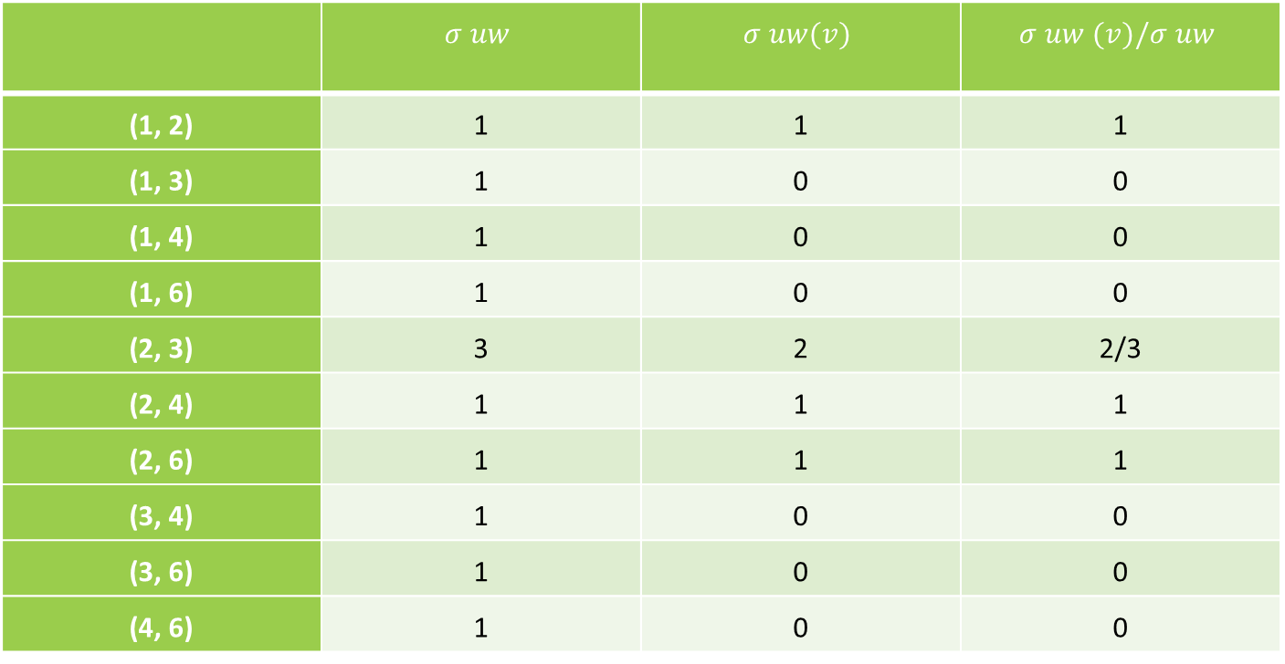
For node 5:
 | $$σ uw$$ | $$σ uw(v)$$ | $$σ uw (v)/σ uw$$
(1, 2) | 1 | 1 | 1
(1, 3) | 1 | 0 | 0
(1, 4) | 1 | 0 | 0
(1, 6) | 1 | 0 | 0
(2, 3) | 3 | 2 | 2/3
(2, 4) | 1 | 1 | 1
(2, 6) | 1 | 1 | 1
(3, 4) | 1 | 0 | 0
(3, 6) | 1 | 0 | 0
(4, 6) | 1 | 0 | 0
Hence, betweenness centrality of 5 is: 3.67

Slide 23
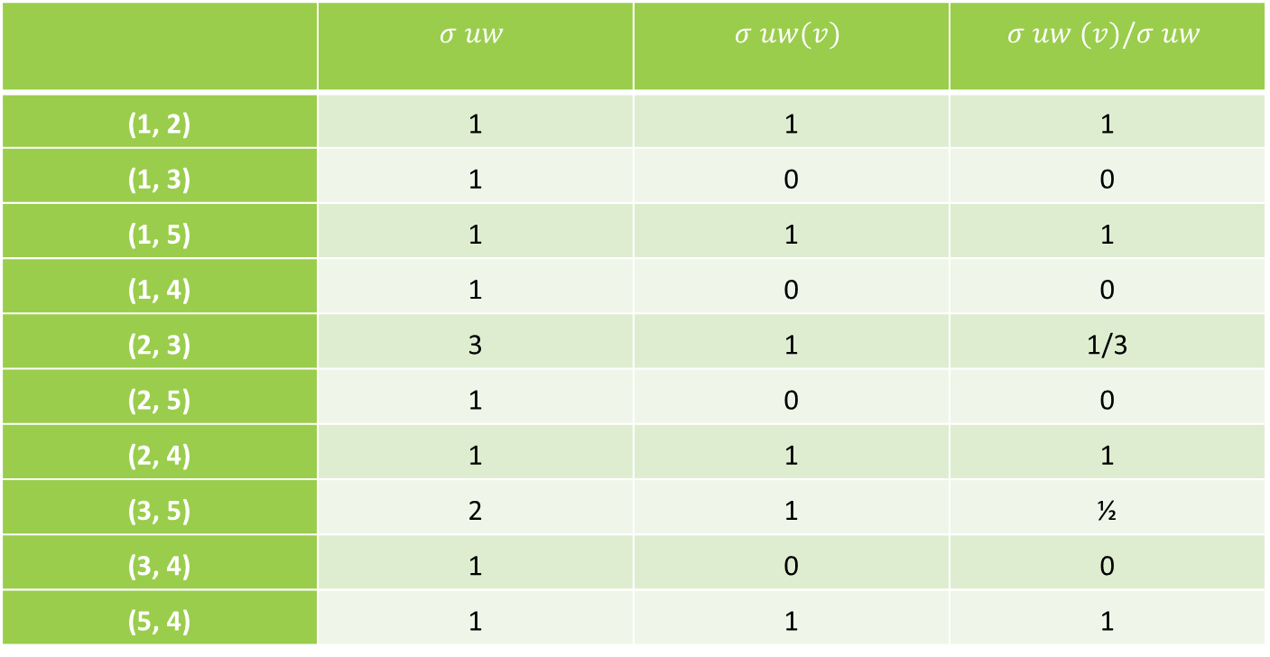
For node 6:
 | $$σ uw$$ | $$σ uw(v)$$ | $$σ uw (v)/σ uw$$
(1, 2) | 1 | 1 | 1
(1, 3) | 1 | 0 | 0
(1, 5) | 1 | 1 | 1
(1, 4) | 1 | 0 | 0
(2, 3) | 3 | 1 | 1/3
(2, 5) | 1 | 0 | 0
(2, 4) | 1 | 1 | 1
(3, 5) | 2 | 1 | ½
(3, 4) | 1 | 0 | 0
(5, 4) | 1 | 1 | 1
Hence, betweenness centrality of 6 is: 4.83

Slide 24
Maximum possible betweenness centrality for an undirected graph (M) is: (N-1)(N-2)/2 = (6-1)(6-2)/2 = 10
Vertex | Betweenness Centrality | Normalized BC ( = BC/M )
1 | 1 | 0.1
2 | 0 | 0
3 | 0 | 0
4 | 3 | 0.3
5 | 3.67 | 0.367
6 | 4.83 | 0.483

Slide 25
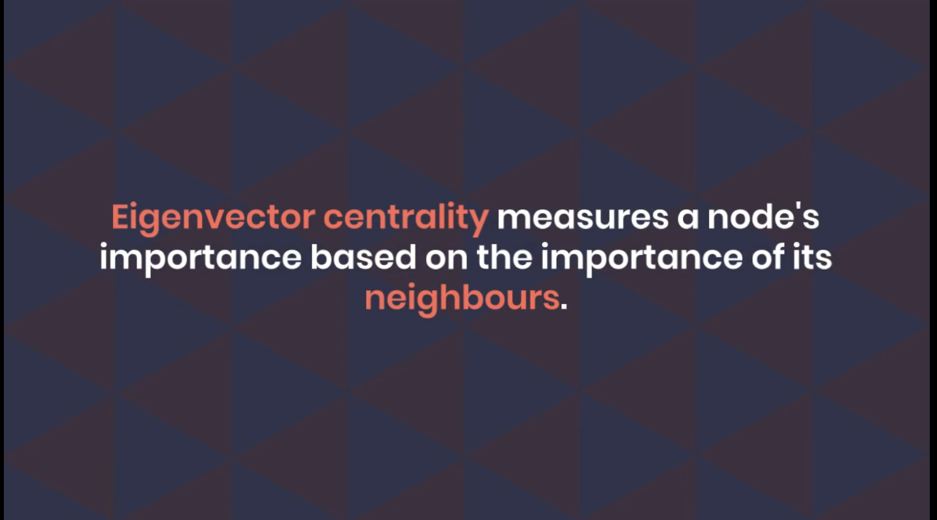

Slide 26
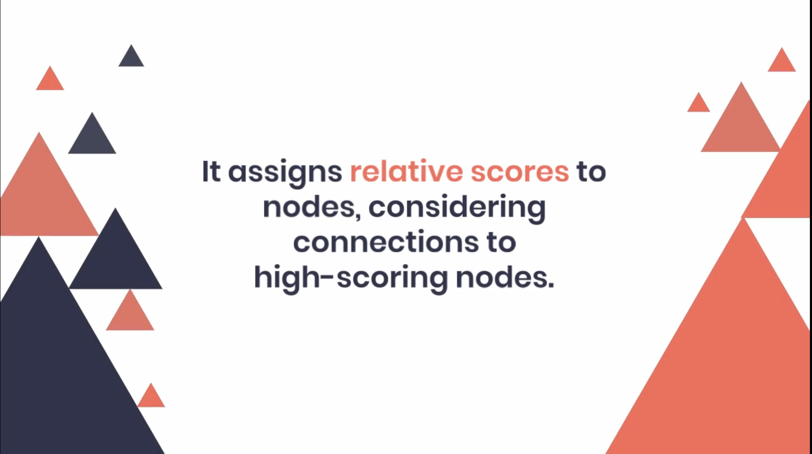

Slide 27


Slide 28
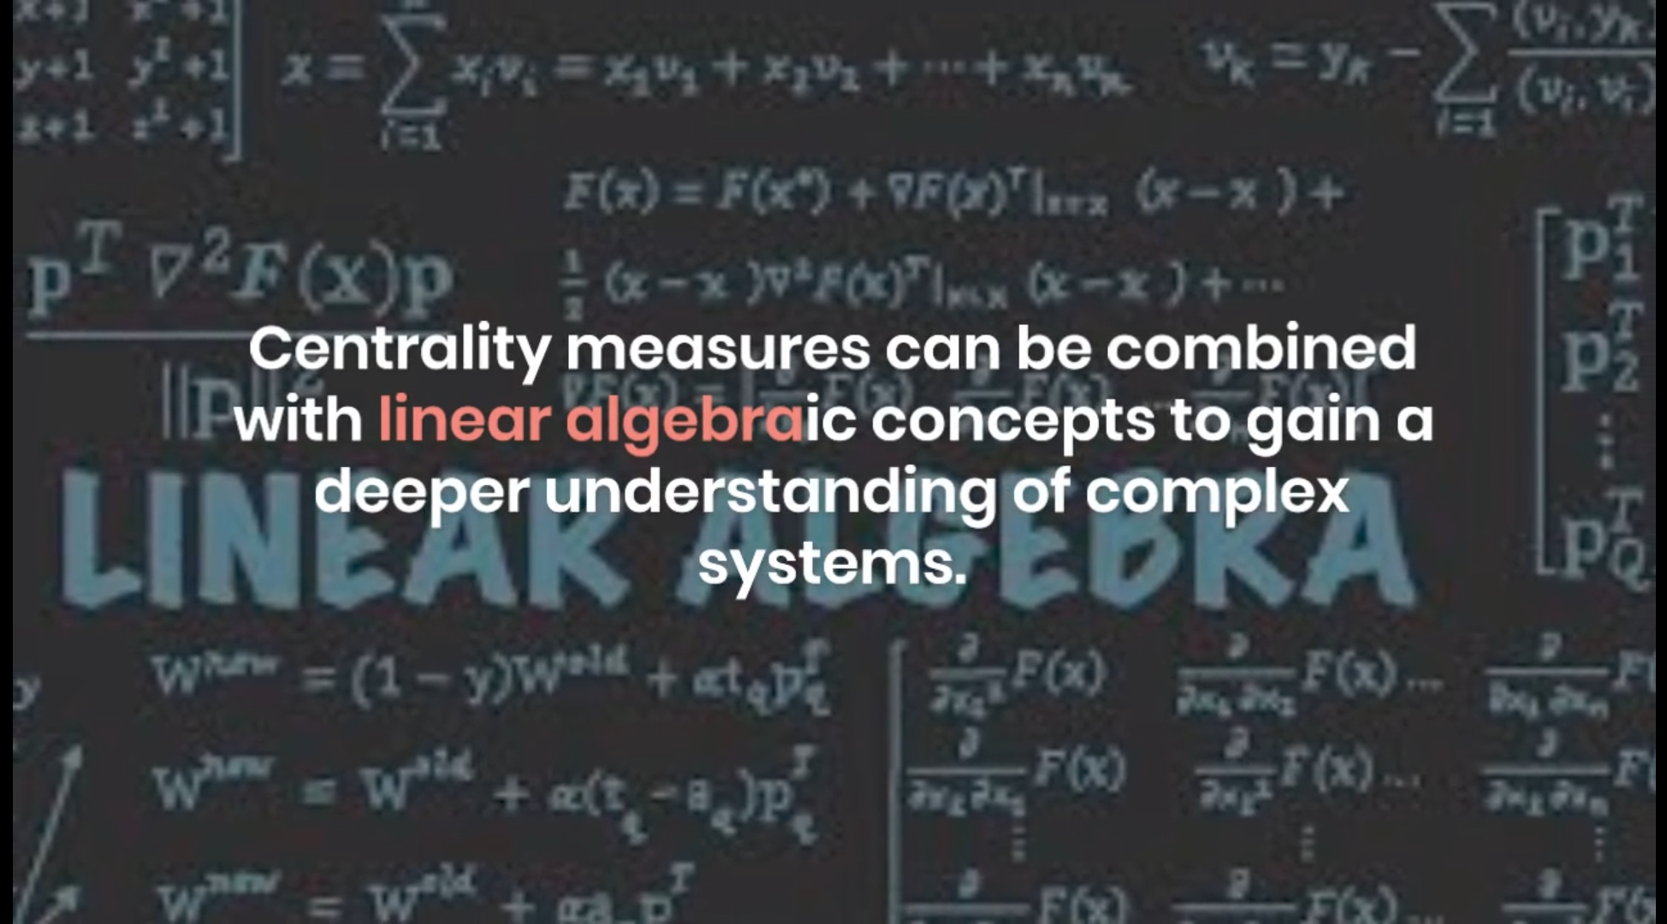

Slide 29
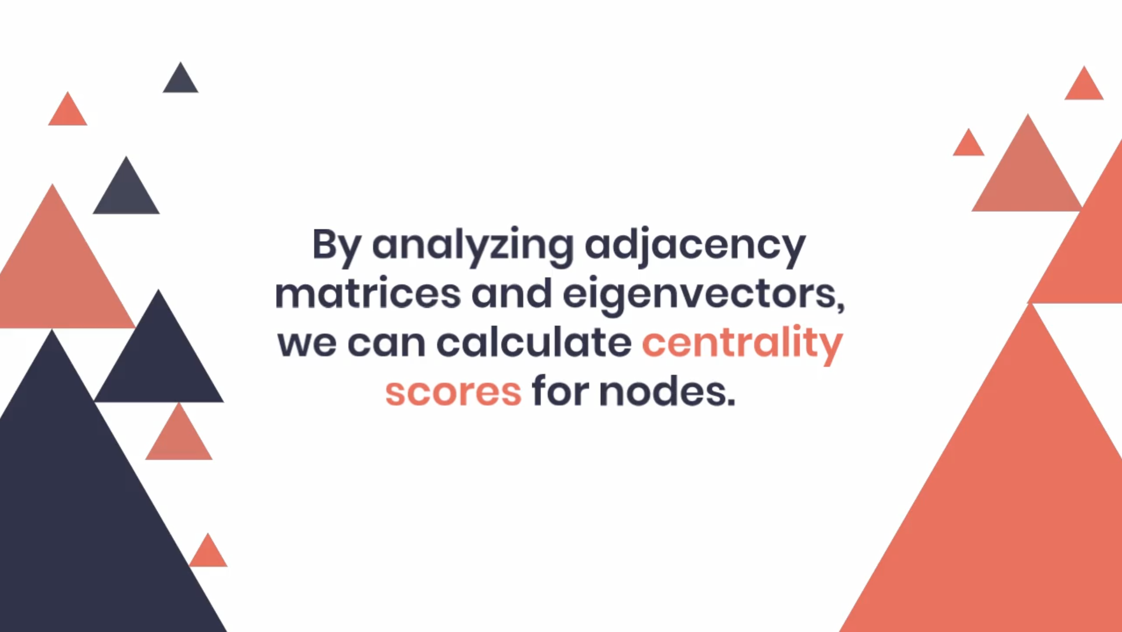

Slide 30
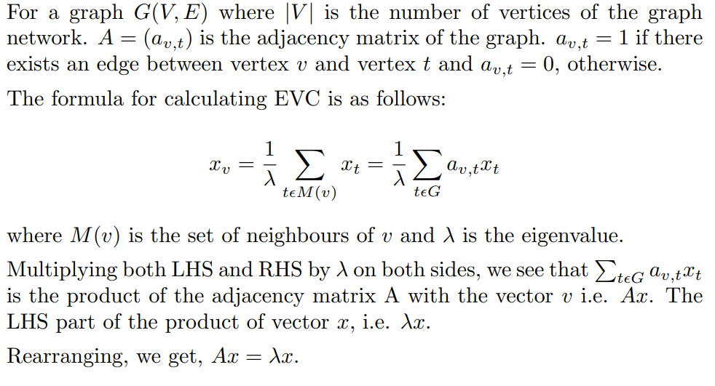
Calculating Eigen vector centrality

Slide 31
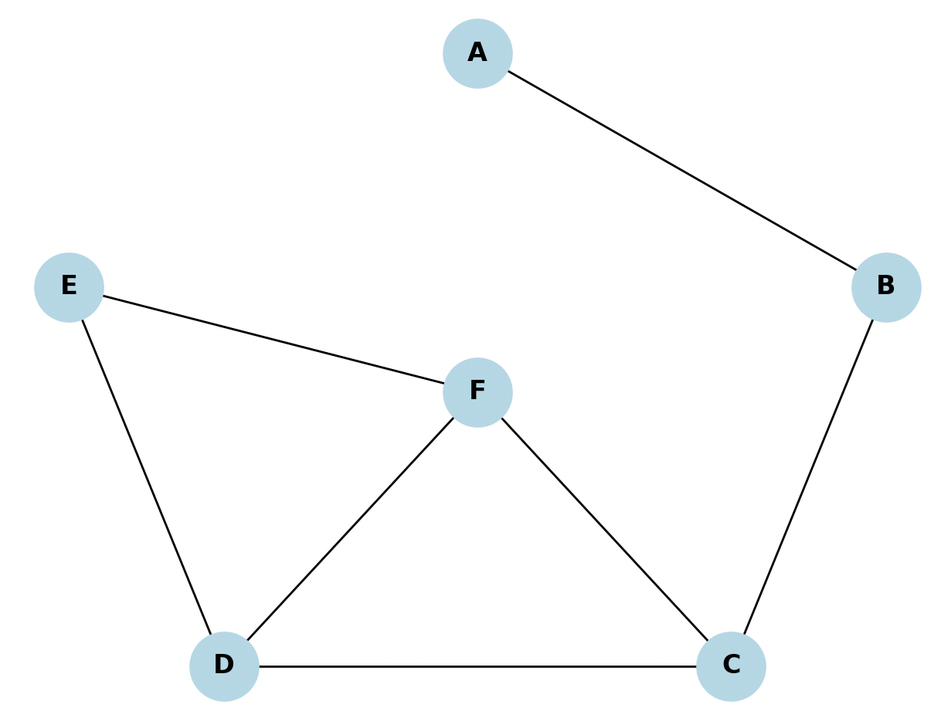
Example for Eigen Vector Centrality

Slide 32
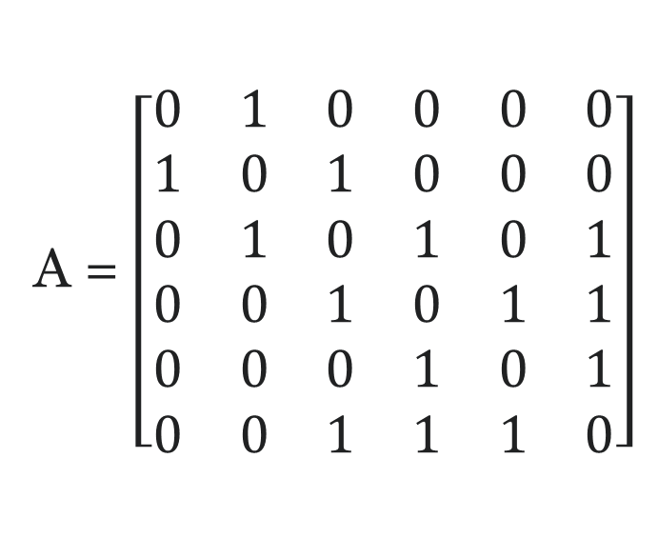
The adjacency matrix is:
A = $\left[\begin{matrix}0 & 1 & 0 & 0 & 0 & 0 \\ 1 & 0 & 1 & 0 & 0 & 0 \\ 0 & 1 & 0 & 1 & 0 & 1 \\ 0 & 0 & 1 & 0 & 1 & 1 \\ 0 & 0 & 0 & 1 & 0 & 1 \\ 0 & 0 & 1 & 1 & 1 & 0\end{matrix}\right]$

Slide 33
Node | Degree
A | 1
B | 2
C | 3
D | 3
E | 2
F | 3

Slide 34
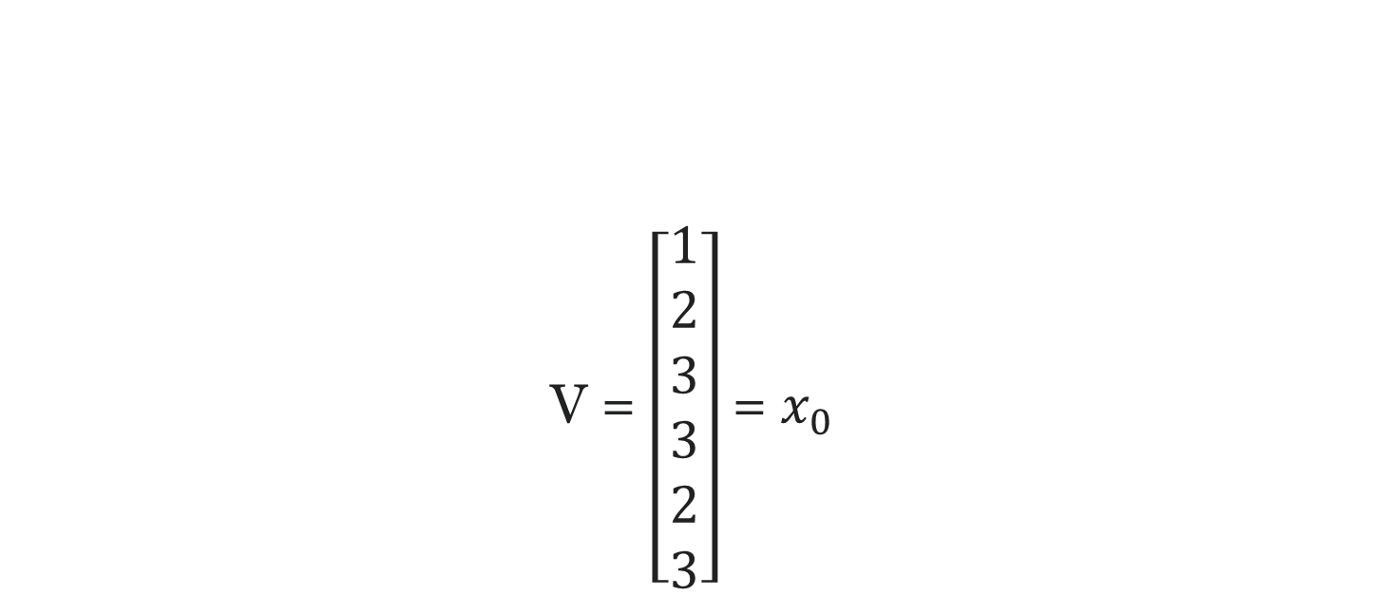
Now, representing the degree of all nodes initially before any iteration in the form of a vector. V = $\left[\begin{aligned}1 \\ 2 \\ 3 \\ 3 \\ 2 \\ 3\end{aligned}\right]$= $x_{0}$

Slide 35
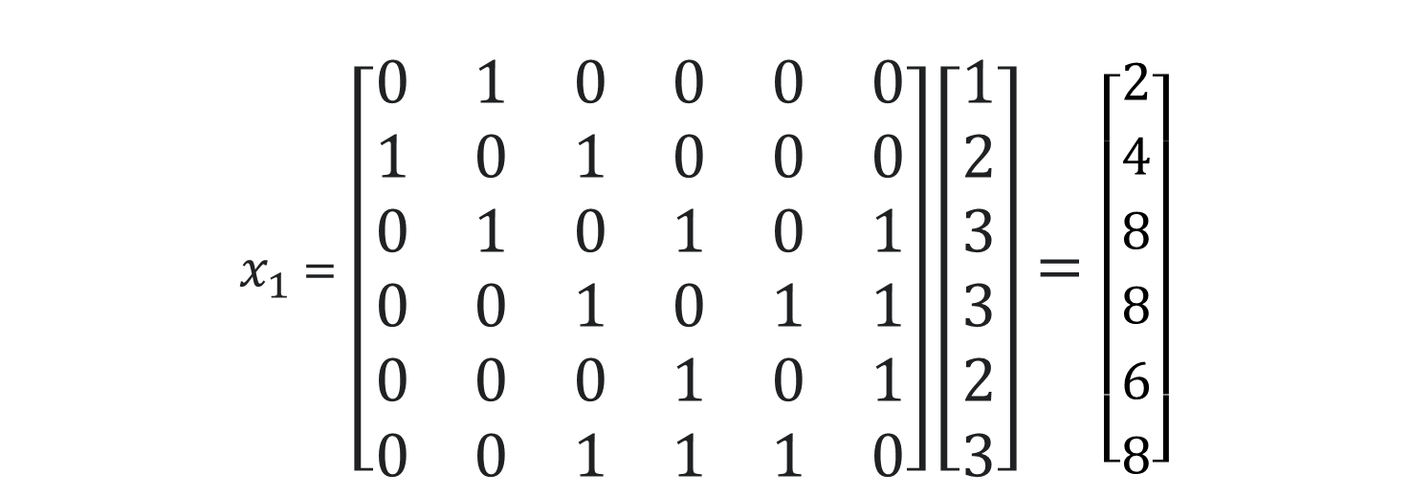

Calculating mathematically the Eigen vector Centrality of each node after first iteration: $x_{1}=Ax_{0}$
$x_{1 }$= $\left[\begin{matrix}0 & 1 & 0 & 0 & 0 & 0 \\ 1 & 0 & 1 & 0 & 0 & 0 \\ 0 & 1 & 0 & 1 & 0 & 1 \\ 0 & 0 & 1 & 0 & 1 & 1 \\ 0 & 0 & 0 & 1 & 0 & 1 \\ 0 & 0 & 1 & 1 & 1 & 0\end{matrix}\right]\left[\begin{aligned}1 \\ 2 \\ 3 \\ 3 \\ 2 \\ 3\end{aligned}\right]=\left[\begin{aligned}2 \\ 4 \\ 8 \\ 8 \\ 6 \\ 8\end{aligned}\right]$

Slide 36
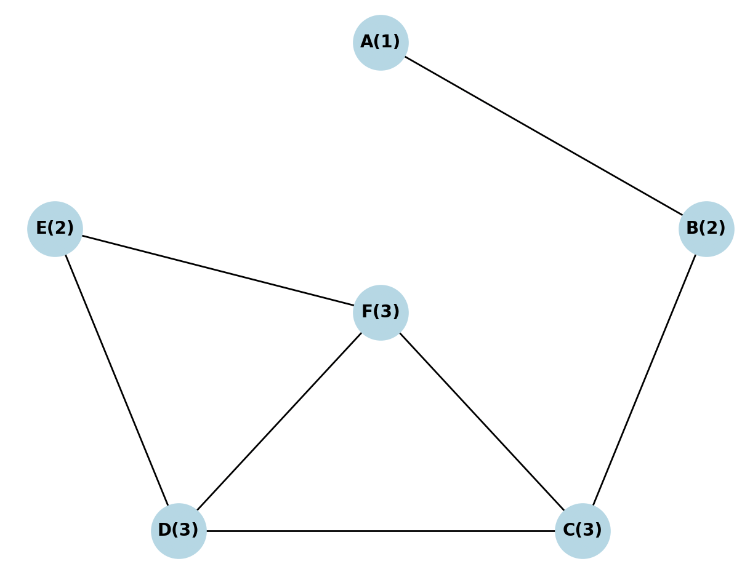
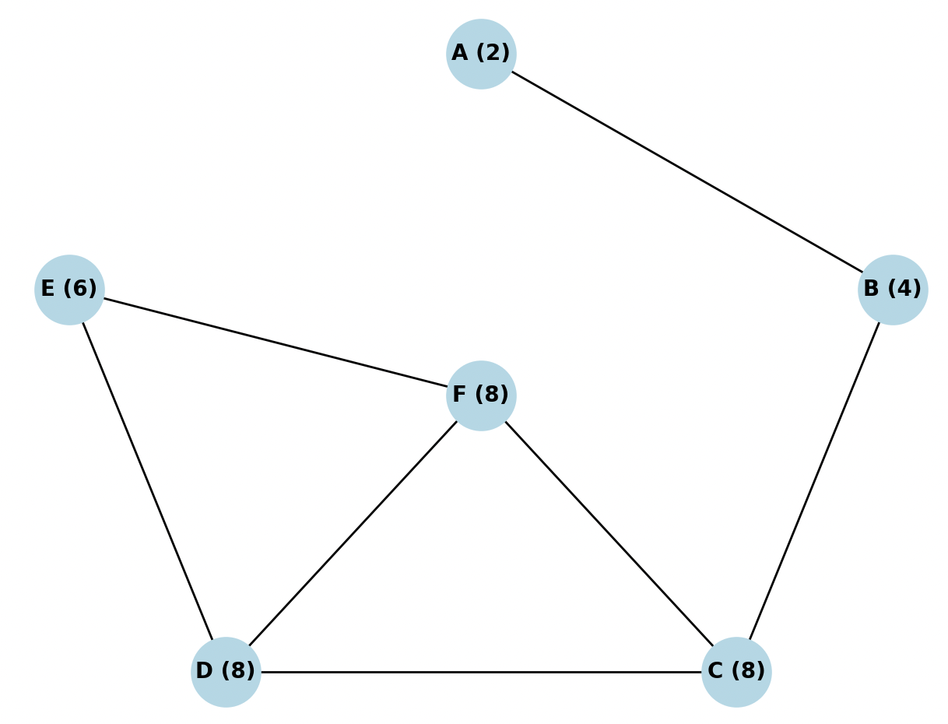

Slide 37
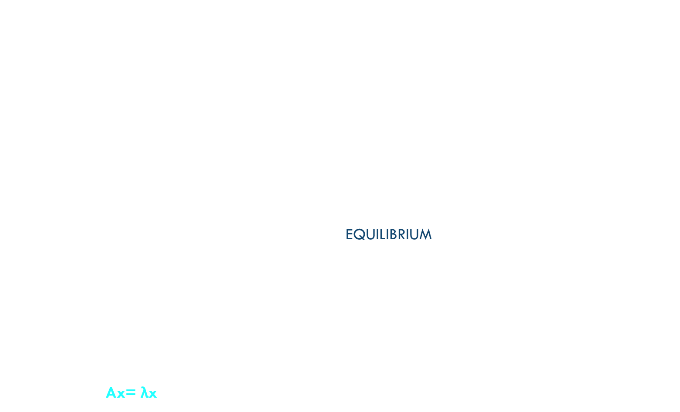
In subsequent iterations of multiplication, the EVC score of graph nodes keeps getting updated by getting impacted by EVC scores from neighboring nodes of farther degree (3rd, 4th and so on). Repeated multiplication makes the EVC score of every node to eventually be a function of or dependent on several degrees of its neighboring nodes, thereby providing a globally accurate EVC score for each node. Usually the process of multiplying the EVC vector with the adjacency matrix is repeated until the EVC values for nodes in the graph reach an equilibrium or stop showing appreciable change. If we normalize the vector and then calculate the subsequent normalized EVC vectors, after certain iterations the EVC values of the nodes would saturate and do not undergo a further change for further iteration. That EVC vector $x$ is the Eigen Vector for that particular graph node network. Ax= λx is satisfied according to the property of Eigen vectors

Slide 38
APPLICATIONS
Degree centrality analysis in social networking plays a pivotal role in understanding the structure and dynamics of social relationships. By measuring the number of connections a node has in a network, degree centrality provides insights into individual popularity, influence, and information dissemination potential. It helps identify influential hubs, brokers, and opinion leaders who serve as bridges between different communities, facilitating the spread of ideas and social influence. Conversely, it highlights individuals who may be isolated or peripheral, offering insights into barriers to information diffusion and social integration. Overall, degree centrality analysis informs marketing strategies, community engagement initiatives, and interventions aimed at understanding and leveraging social network dynamics.

Slide 39
APPLICATIONS
Betweenness centrality has diverse applications, and one notable use case is in the analysis of criminal or terrorist networks. Nodes with high betweenness centrality in such networks often indicate crucial or highly involved actors. These nodes exert control over the flow of data among different groups, serving as bridges for information dissemination. Nodes with high betweenness centrality hold favorable positions in the network, facilitating greater control over information propagation. As a consequence, they become potential single points of failure. Disrupting or removing these nodes can effectively hinder communication and disrupt the network’s operations.

Slide 40
APPLICATIONS
Google's PageRank algorithm uses eigenvector centrality to rank web pages in order of their importance. The idea behind PageRank is that a web page is considered important if it is linked to by other important web pages. It treats the web as a directed graph, where each web page is a node and the links between them are the edges. The PageRank algorithm starts by assigning an initial score to each web page. These scores are then updated iteratively based on the scores of the pages that link to them. The update process involves calculating the eigenvector centrality of each page, considering both the incoming and outgoing links. In terms of linear algebra, the PageRank algorithm represents the web graph as a stochastic matrix, typically referred to as the transition matrix. This matrix describes the probability of transitioning from one page to another through a link. The PageRank scores of the pages are obtained by finding the principal eigenvector of this transition matrix.

Slide 41
APPLICATIONS
The eigenvector corresponding to the principal eigenvalue represents the stationary distribution of the random walk on the web graph. The PageRank scores are essentially the elements of this eigenvector, indicating the relative importance or popularity of each page in the network. By utilizing eigenvector centrality, Google's PageRank algorithm considers the global structure of the web graph and determines the importance of a page based on its connections to other important pages. This approach helps in ranking web pages and determining their relevance for search engine results. Overall, eigenvector centrality and the concepts from linear algebra play a crucial role in Google's PageRank algorithm by providing a mathematical framework to assess and rank the importance of web pages in a network of interconnected links.

Slide 42
Team number 9
Gargie Tambe – 2022111008 - Worked on Degree Centrality and designed the mid-report, end-report
Chetan Krishna – 2022102047 - Worked on Eigen-Vector Centrality
Asish Bharadwaj – 2022101100 – Worked on Betweenness Centrality and presentation

Slide 43
THANk you

